Slide 1
Metabolomics using SWATH™ Acquisition
Brigitte Simons, Ph.D.
AB SCIEX, Toronto, CAN

Slide 2
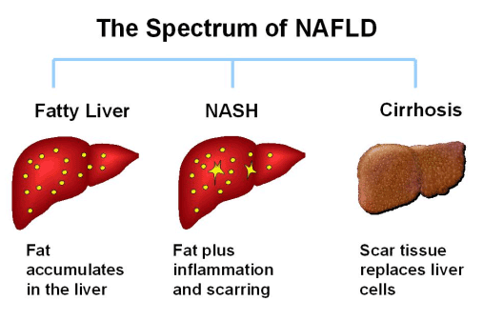
Non-Alcoholic Fatty Liver Disease
Lipid Profiling of Liver Tissue Research Study
Non-alcoholic fatty liver disease (NAFLD) includes the manifestation of non-alcohol steatohepatitis (NASH) and hepatic steatosis (SS)
PC/PE ratio can provide monitoring of the integrity of hepatocyte cell membranes and an important marker in NAFLD pathogenesis
Fatty acid profile can provide insights into hepatic enzymatic activity and fat metabolism
Puri, P., Wiest, M.M., Cheung, O., Mirshahi, F., Sargeant, C., Min, H.K., Contos, M.J., Sterling, R.K., Fuchs, M., Zhou, H., et al. 2009. The plasma lipidomic signature of nonalcoholic steatohepatitis. Hepatology 50:1827-1838.
Notes:
Non-alcoholic fatty liver disease (NAFLD), which includes simple hepatic steatosis (SS) and non-alcoholic steatohepatitis (NASH), is considered to be the hepatic manifestation of the metabolic syndrome (1) and is associated with profound changes in lipid metabolism
Phospholipids are the main cell membrane lipids
PE, PI, PS mainly on the inside leaflet of the membrane bilayer, PC mainly on the outside. Therefore maintaining the correct ration between PC and PE provides proper membrane integrity and fluidity for normal liver function. Non-alcoholic fatty liver disease is defined as uncontrolled fat accumulation resulting in inflammation in the liver tissue, elevated liver enzymatic activity and ultimately liver failure. This is also called steaotohepatitis.
[FA moiety determines membrane fluidity]
The lipidomics of liver tissue from patient biopsies could uncover a diagnostic marker for potentiating the disease. It is thought that an unbalanced PC/PE ratio could represent a marker steatohepatitis. Also, the fatty acid profile can provide information regarding membrane fluidity and enzymatic activity implicated in the improper fat storage and metabolism.

Slide 3
NAFLD and Lipid Analysis
Changes in FA composition has been shown in NAFLD vs. controls
  Lower n-6 and n-3 PUFA, n6/n3 ratio higher
  Due to oxidative stress, altered desaturase activity
    (Allard et al. 2008 J Hepatol; Puri et al. 2007 Hepatol; Araya et al. Clin Sci 2004)
Liver: Lower amount of PC associated with steatosis, but lower PC/PE ratio with inflammation
  (Li et al. Cell Metab 2006)
Fatty Liver in the ob/ob mouse model:
  Decreased number of correlations among lipid species, showing decreased co-regulation
  Short, medium chain TAG and ceramides ↑
  (Yetukuri et al. 2007 BMC Syst Biol)
Adipose tissue in adipose women with/without fatty liver:
  154 lipid species significantly altered
  Especially TAG, particularly long chain, and ceramides, specifically Cer(d18:1/24:1) ↑
  (Kolak et al. 2007 Diabetes)
Notes:
The amount and balance of phosphatidylcholine (PC) and phosphatidylethanolamine (PE), the
90 two major cell membrane phospholipids, may be of special importance. PC is produced in most
91 mammalian cells from dietary choline, and to a lesser extent in the liver from PE via the PE N-
92 methyltransferase (PEMT) pathway (Cui and Houweling 2002, Li et al. 2006).
PC biosynthesis is necessary for normal very low density
95 lipoprotein secretion from hepatocytes (Zeisel 2006), hence, a reduction in PC, e.g. through
96 choline deficient diets, might lead to hepatic steatosis

Slide 4
Study Design
Cross-sectional study
Including patients with NAFLD (n=28), chronic Hepatitis C (n=13) and healthy living liver donors as controls (n=9)
Lipidomic analysis (including PC/PE ratio) in liver tissue
Other measurements: Demographics, anthropometry, dietary intake

Slide 5
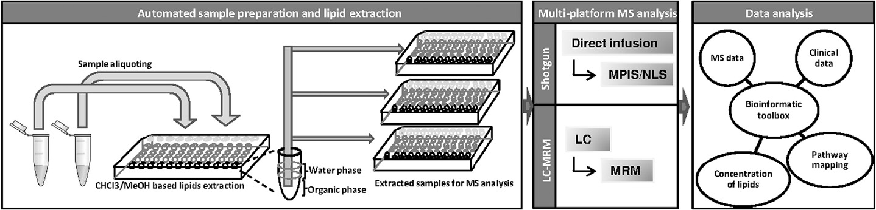
Molecular Lipidomics Platforms
H.R. Jung et al. (2011) Biochimica et Biophysica Acta; 1811; 925-937
150 μl liver homogenate (containing 0.15 – 2.49 mg of liver tissue) mixed with 4 ml of chloroform: methanol (2:1) (v/v) with 0.02% butylated hydroxytoluene as antioxidant
1 part aqueous (sample extract), 2 parts MeOH, 0.9 part CH₂Cl₂; Add 1 part H₂O, 1 part CH₂Cl₂, 10 mM LiCl; Vortex & spin - take lower layer
Lipids were diluted with chloroform to 0.08 mg/mL final concentration and diheptadecanoyl PC and PE were added as internal standards at 0.15 μmol/L final concentration.
Samples were further diluted 1:1 with chloroform:methanol (1:2, v/v) with 5 mM ammonium acetate and analyzed by nanoelectrospray infusion tandem mass spectrometry

Slide 6
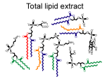
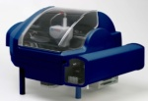
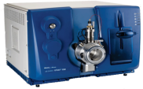

Shotgun Lipidomics of Human NAFLD Liver Tissue
Lipid Profiling of Complex Extracts by Direct Infusion
Clinical lipid biopsies: healthy controls = 9 samples ; NAFLD = 28 samples; CHC = 13
>30 min
< 1 min
3.1 min per sample
30 min analysis time
Total lipid
extracts
Automated
sample
infusion
Multiple
Precursor
Ion Scanning
Lipid
identification
and
quantification
Result reporting
Liver Biopsies
Advion
NanoMate TriVersa
QTRAP® 5500 System
LipidView™ Software
Infusion-quantitation
Ekroos, K et al., Methods in Pharmacology and Toxicology: Biomarker Methods in Drug Discovery and Development, Humana Press 2008
Ståhlman, M et al. High-throughput shotgun lipidomics by quadrupole time-of-flight mass spectrometry, J Chrom B 2009
Arendt et al., Non-alcoholic fatty liver disease is associated with lower hepatic and erythrocyte ratios of phosphatidylcholine to phosphatidylethanolamine, Applied Physiology, Nutrition and Metabolism, Oct 2012.
Notes:
To study this liver disease, a targeted shotgun lipid profiling of clinical liver tissue extracts from human patients was carried out. We obtained extracts from 9 healthy control patients and 28 samples from fatty liver tissue biopsies. Samples were normalized for total lipid concentration and then diluted in the electrospray solvent shown. A cocktail of lipid-class specific internal stds is spiked into each extract and the total, unfractionated extracts are infused into the QTRAP system using the Triversa Nanomate. We then carryout multiplexed precursor scanning methods by direct infusion in fast acquisition speeds in both polarities. The data is then processed using new software called LIpidView for lipid identification and quantification.
Note to speaker: more difficult to obtain healthy control samples this is way the numbers of patients per class are so different.

Slide 7
Multiplexed Precursor Ion Scanning [XPIS]
Select lipid-specific fragment
Scan Precursors
CAD
Full range Q1 scan
Exp 1
m/z
Q1
LINAC Q2
Q3
Exp 2
Technical benefits of Multiplexed Precursor Ion Scanning [XPIS] for lipid quantitation
    All desired lipid classes and their internal standards are detected in parallel looped acquisitions
Spectra are directly interpretable and can be overlaid for comprehensive lipid characterization
Transitioning from PIS to MRM can be easily achieved for highly multiplexed and robust relative lipid quantitation
m/z
Exp 3
m/z
Ekroos, K et al. Analytical Chemistry 2002.
Notes:
Precursor Ion scanning is traditionally used to profile lipids of a given class by a characteristic fragment ion.
Q1 sweeps a given mass range
Q3 is fixed on mass of a lipid-class specific fragment or fatty acid acyl ion
Only ions passed through Q1 that produce the diagnostic fragments will produce signal at the detector
[Click through]
To screen for a panel of lipid classes or fatty acids, multiple precursor ion experiments can now be carried out in parrallel benefiting from fast quadrupole scanning, polarity switching, and improved resolution.
The technical benefits of XPIS is that all a broad range of lipid classes and their internal standards can be detected in a single acquisition method. Complementary scan data can be overlaid for more comprehensive lipid molecular characterization, and bridging XPIS to MRM can be easily achieved for more robust targeted quantitation.

Slide 8
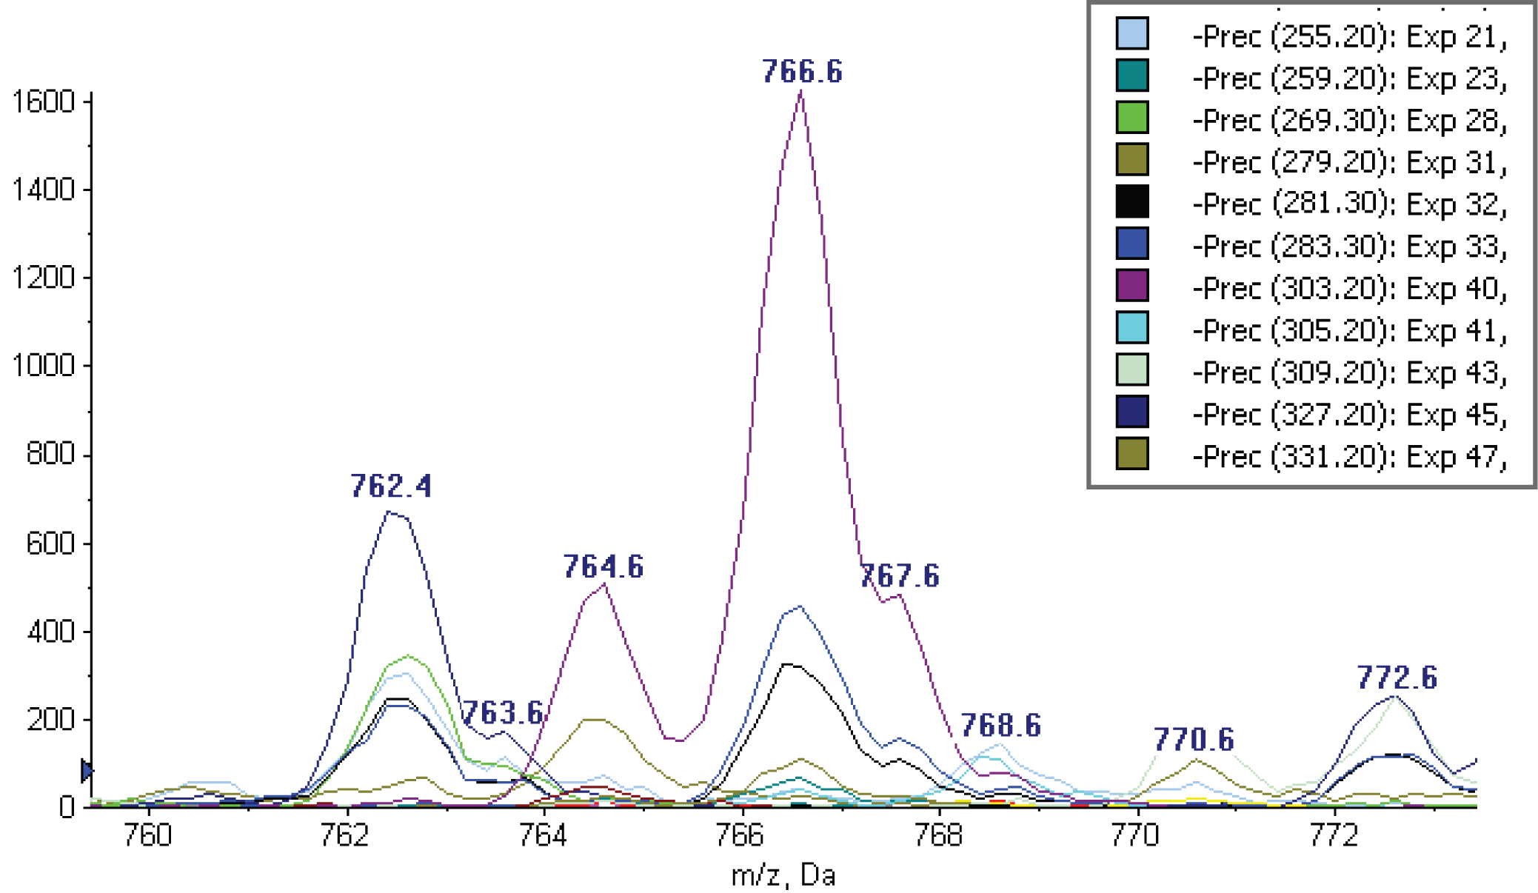
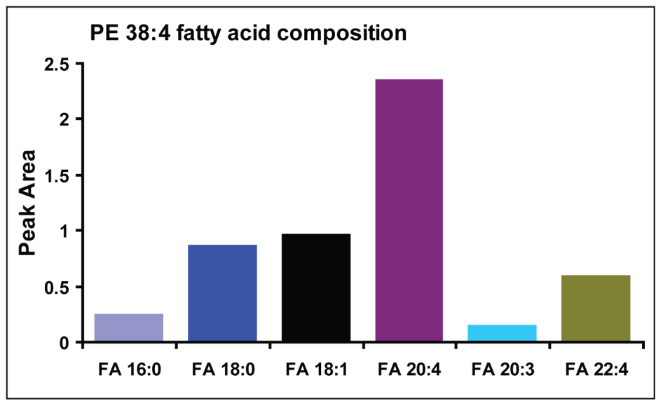
Technical Benefits of Multiplexing PIS
Precursor Fragmentation Profiles Are Overlaid for Lipid Species Characterization and Quantitation
PE 38:4
Notes:
To clarify the benefits of using multiplexed precursor ion scanning methods, this slide shows the overlay of 11 different PIS experiments acquired in a single looped acquisition to profile several common fatty acid acyl ions associated with the glycerophospholipids parent ions shown in this spectrum.
[click]
We can identify this peak of mass 766.6 as PE 38:4 by database searching, but it is the complementary FA scanning that allows us to identify the fatty acid molecular composition of the PE 38:4 isomers contained within the peak shown here at 766.6 m/z.
These PIS peaks can be extracted, corrected for isotopic responses, and integrated for relative quantitation against the di-heptanoyl phosphatidylethanolamine internal standard peak.

Slide 9
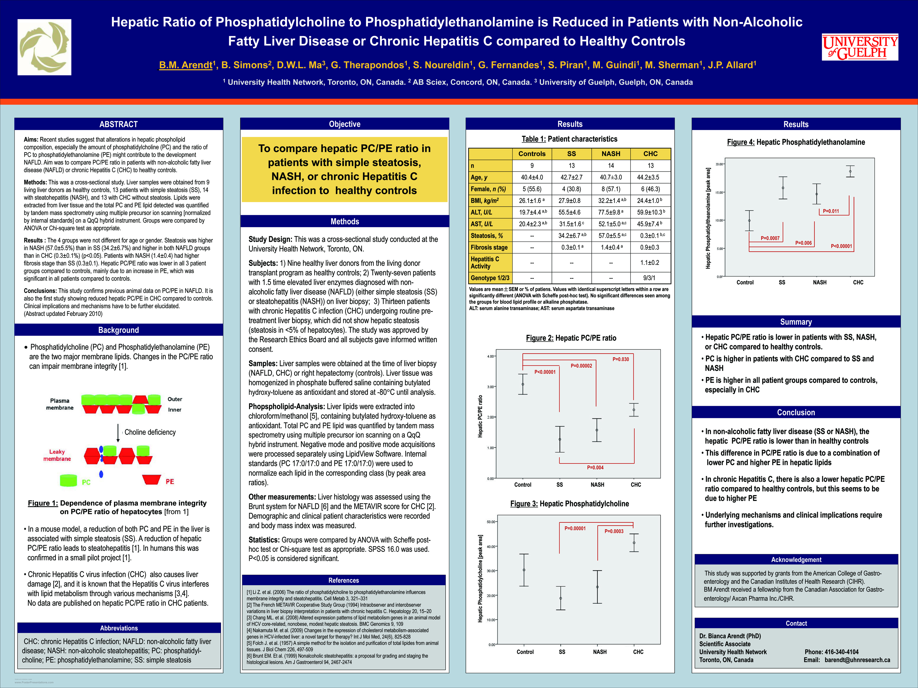
Hepatic PC/PE Ratios Calculated Individually Per Patient by IS Corrected Peak Area Ratios
Mean = 3.27 ± 0.60
Mean = 1.25 ± 0.79
Arendt et al., Non-alcoholic fatty liver disease is associated with lower hepatic and erythrocyte ratios of phosphatidylcholine to phosphatidylethanolamine, Applied Physiology, Nutrition and Metabolism, Oct 2012.

Slide 10
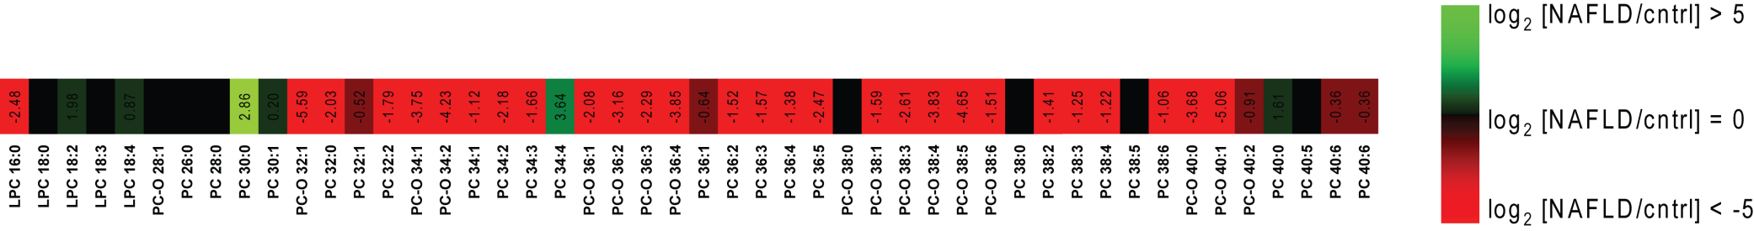
Hepatic PC Measured by IS Corrected Peak Area Ratios

Slide 11
Hepatic PE Measured by IS Corrected Peak Area Ratios
Arendt et al., Non-alcoholic fatty liver disease is associated with lower hepatic and erythrocyte ratios of phosphatidylcholine to phosphatidylethanolamine, Applied Physiology, Nutrition and Metabolism, Oct 2012.

Slide 12
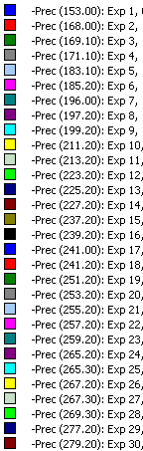
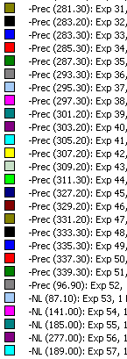
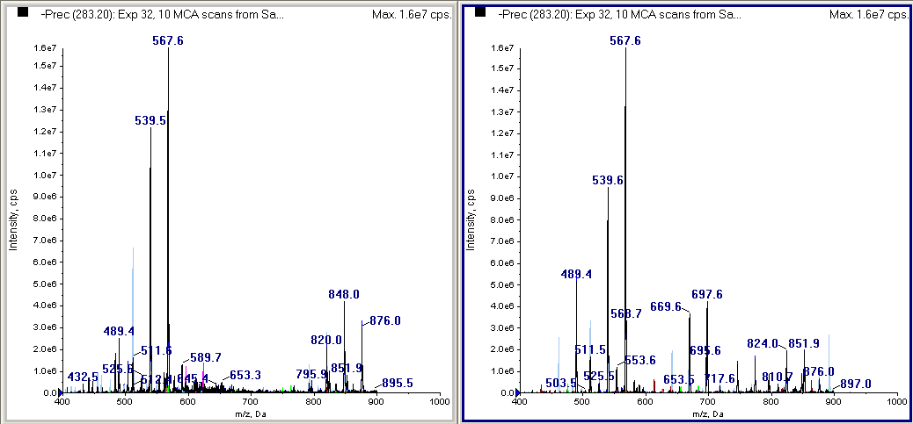
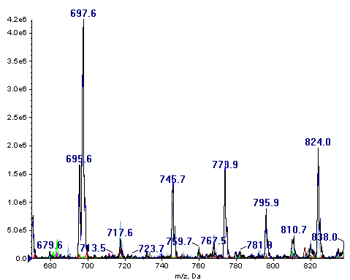
Multiplexed Precursor Ion Scanning on the QTRAP® 5500 System
Enabling Up to 60 Precursor Ion Experiments Scanned in Parallel in Both Polarities
Liver Tissue Lipid Extract
RBC lipid extract
Notes:
To take a look at the raw data from this study, the mass spectrum shown here is the result from a multiplexed precursor ion scanning acquisition of which all scans are overlaid according to the legend shown. By direct nanoelectrospray infusion, all these PIS experiments were acquired in parallel in 6.3 min at 2000 Da/s.
[Click]
We can align this spectrum beside an identical acquisition strategy for red blood cell lipid extract experiment and visibly see some differences, especially in this expanded view of the mass range.
In order to carryout the lipid ids from such an extensive clinical dataset new lipid software application now enables the batch processing in mid to high-through-put for relative quantitation of all glycerophospholipids of all patients.

Slide 13
The advent of High Resolution MS in metabolomics…
  Improved the quality and confidence in the answers obtained
    By providing elemental formula confirmation, isotope pattern match
    Accurate mass fragment information for improved structure interpretation
  Enable simultaneous Qualitative and Quantitative data collection
  Stream lined a generic data collection practice of MS and NOW MS/MS simultaneously
….MS/MS data simultaneously collected is advantageous yet reproducibility and remains challenging
  Targeted MS/MS data collection is still the best in terms of selectivity
    But not realistic in discovery mode
  Automated data collection using IDA imposes prioritization
    Mass defect filters, isotope filters, background subtraction…
    Very effective, but each compound requires its own MS/MS trigger point
  MS^{all} (or MS^{e}) can make acquisition more generic
    But this approach heavily relies on LC separation capability
    Related compounds (drugs, inhibitors, activators) can easily be handled by UPLC
    But endogenous matrix species can increase complexity beyond UPLC’s capability
      Multiple co-eluting species can complicate the MSMS information if no precursor selection occurs

Slide 14
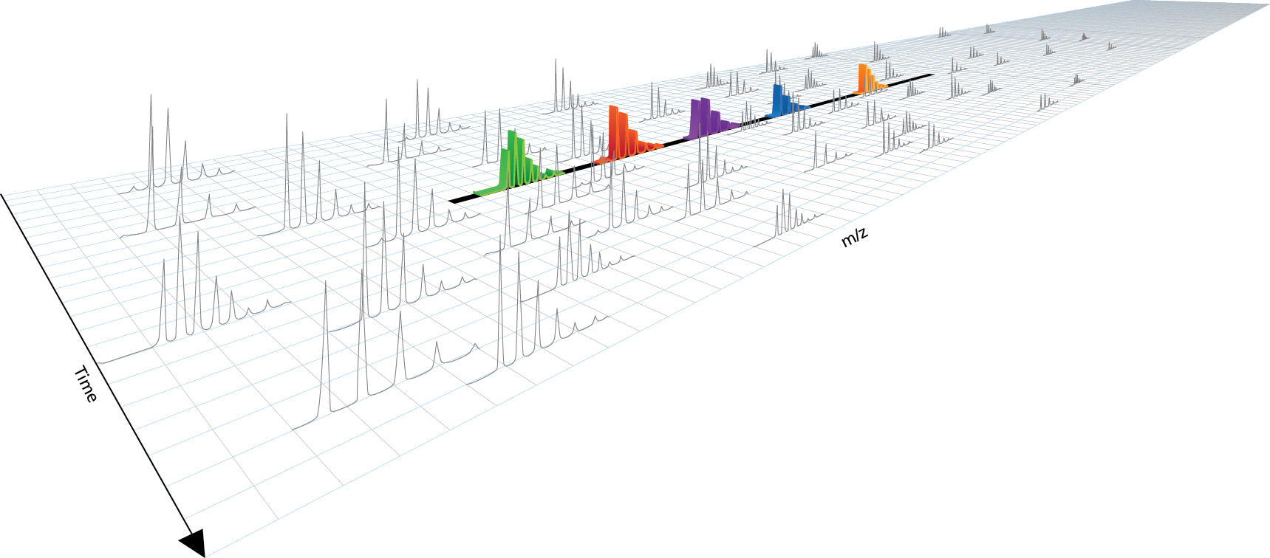
SWATH™ Acquisition
What is it?
MS/MS^{ALL}
  A unique data-independent workflow enabled by TripleTOF® system technology that acquires high resolution quantifiable MS/MS data for all detectable analytes in a complex sample, in single run
How does it work?
SWATH™ Acquisition
  Use of a wide isolation window stepping across a mass range, collecting high resolution MS/MS spectra in a chromatographic time scale
  Data processing via post-acquisition fragment ion XICs at high resolution for quantitation of thousands of peptides and confirmation of identity

Slide 15
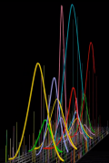
Comprehensive Quantitation
cycle time
~ 2.5 s
Wide Q1 isolation (25 Da)
TripleTOF speed allows full coverage of mass range
High resolution XIC data for all fragment ions
m/z
SWATH = 25 Da
retention time
Notes:
First, let’s discuss what we mean when we say “comprehensive quantitation.” This schematic shows how the data acquisition works. A wide Q1 isolation window scans across the entire mass range of the experiment, fragmenting all detectable ions. The result is full scan MS/MS data for everything we can see in the sample, from which we can extract high resolution XICs for reproducible quantitation.

Slide 16
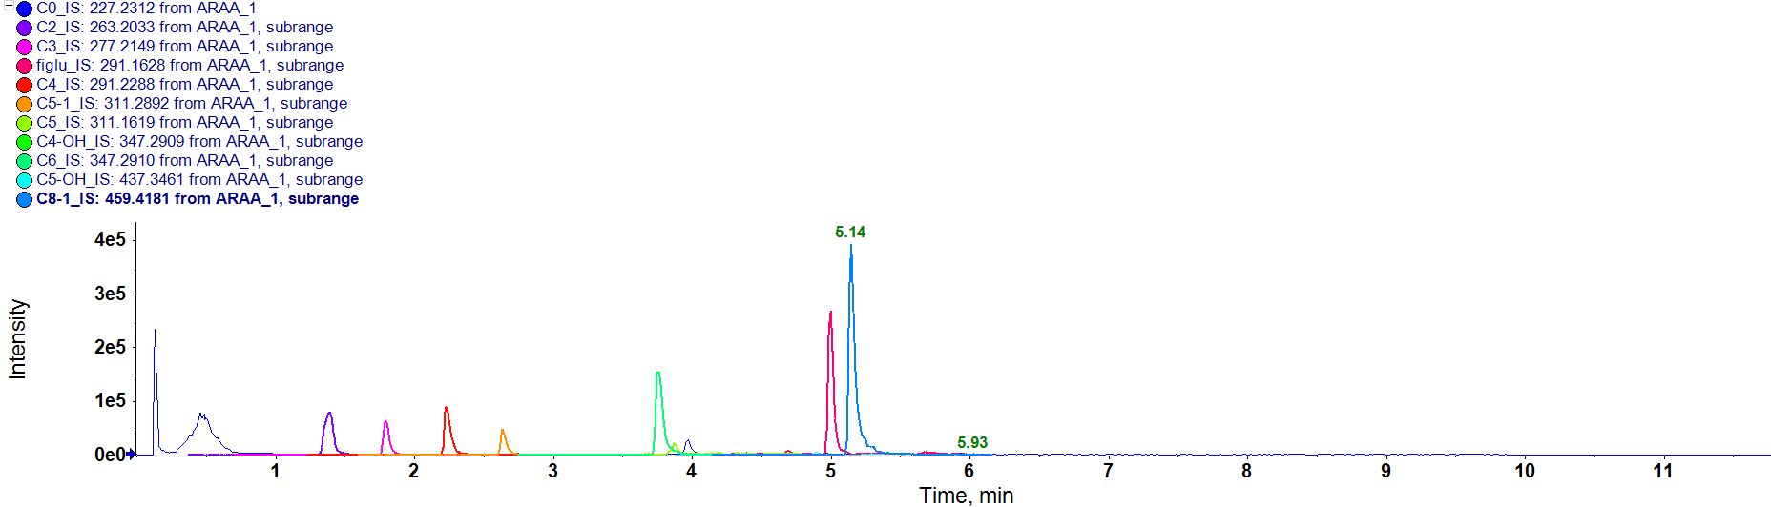
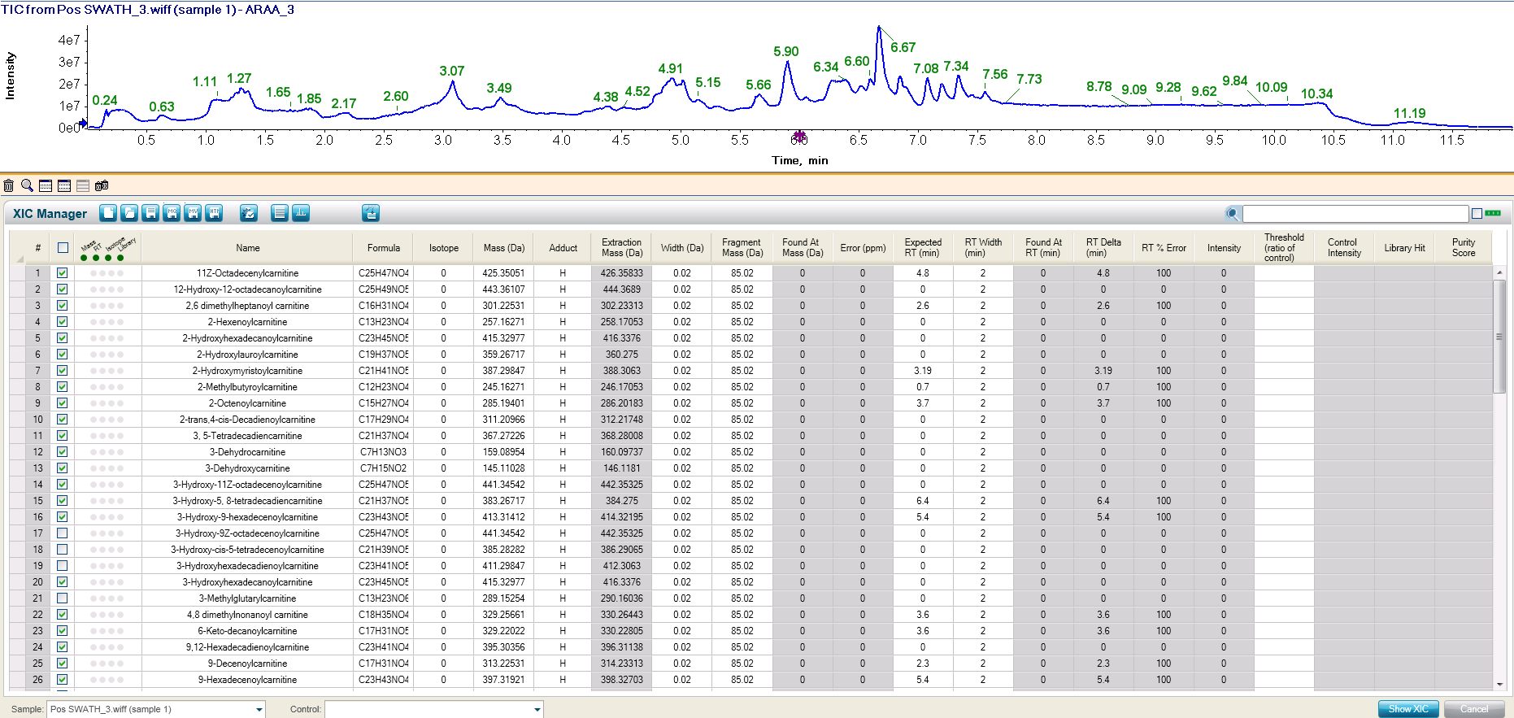
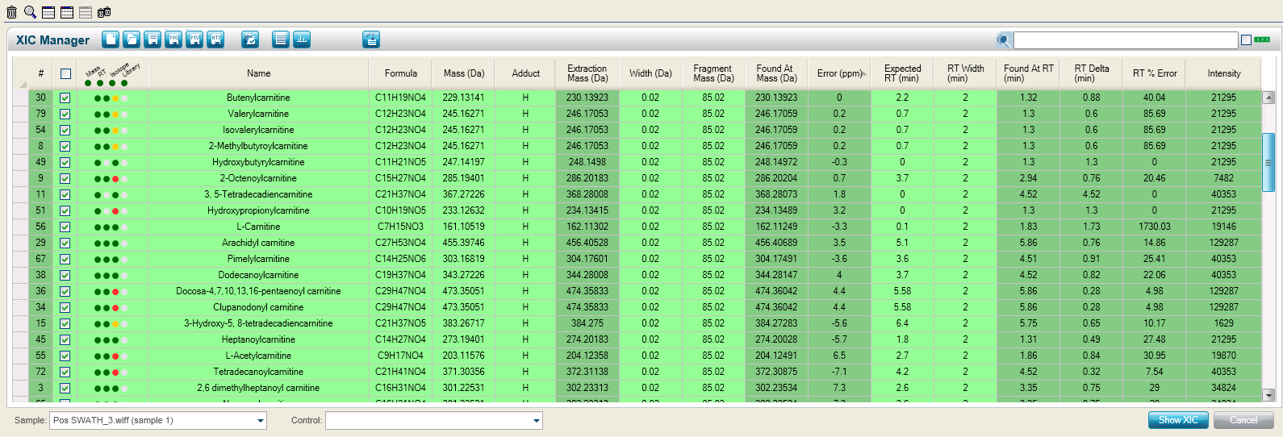
Metabolite Fishing….
Acylcarnitine Profiling in CSF Extracts
Accurate mass XICs of all 48 targeted acylcarnitine species
XIC quant Summary Table

Slide 17
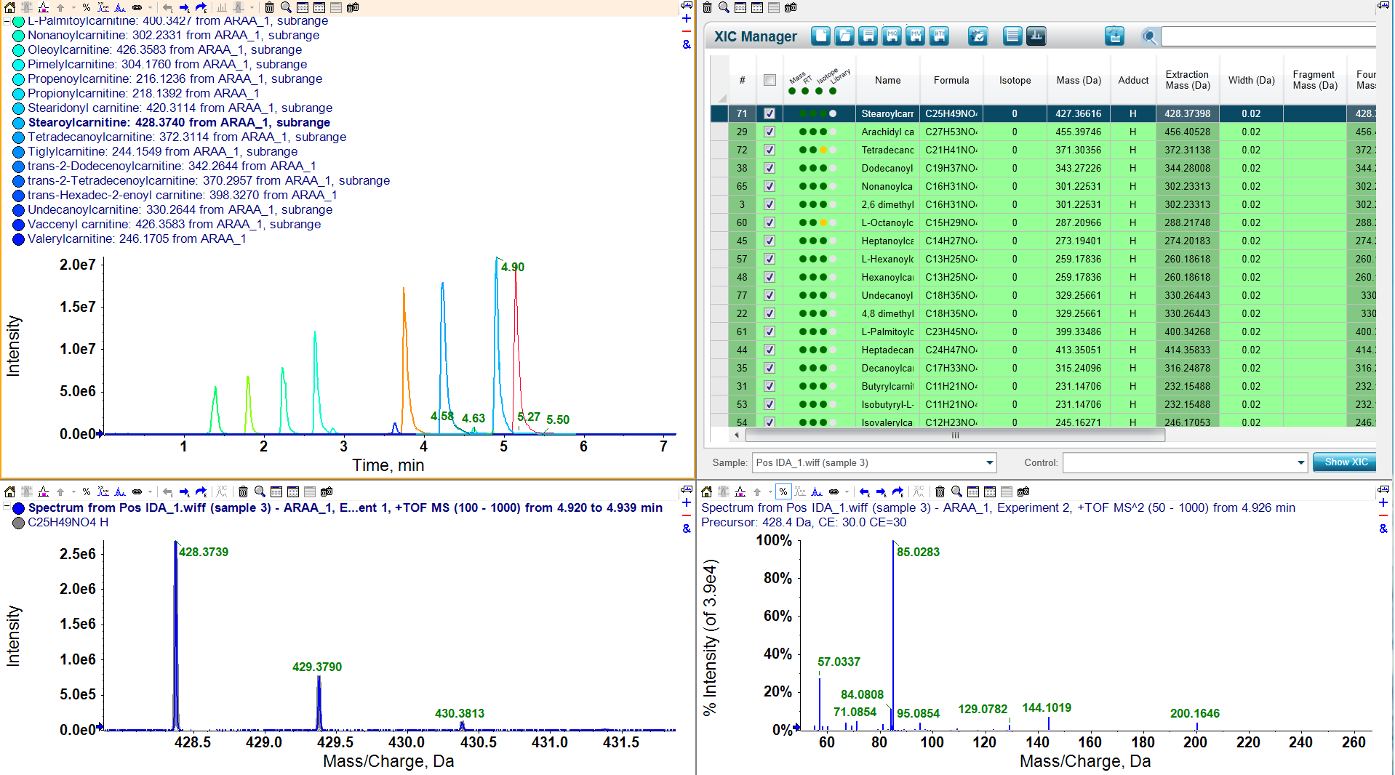
Acylcarnitine Quant Summary with Confirmation
SWATH for Targeted Screening
Acylcarnitine C18
C₂₅H₄₉NO₄
MS/MS for confirmation

Slide 18
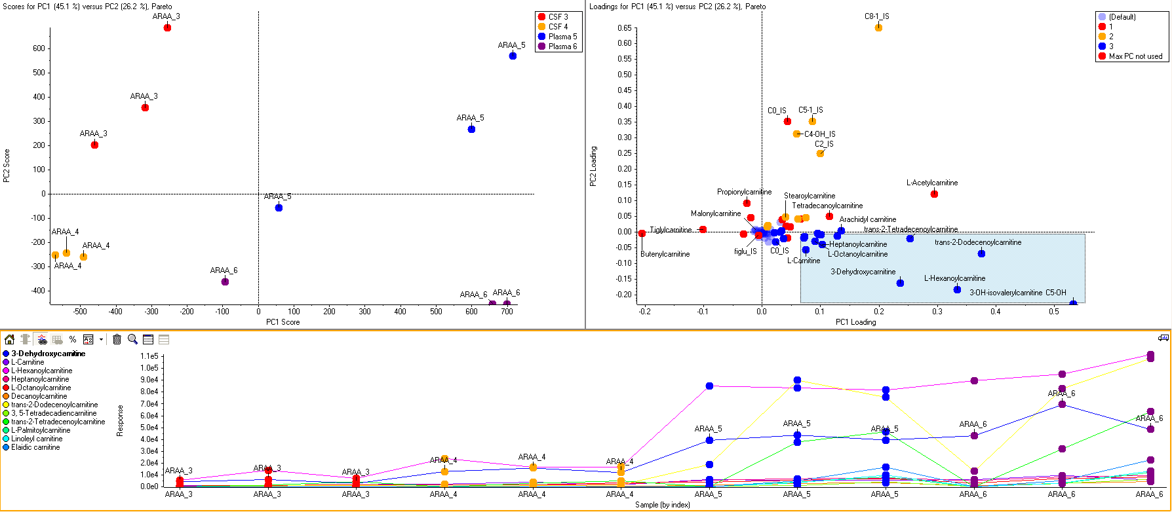
Acylcarnitine Profiling in MeOH CSF & Plasma Extracts
MarkerView Software for PCA and Multivariate Statistical Analyses
Plasma
CSF

Slide 19

Comprehensive Quant/Qual Metabolomics
SWATH™ Acquisition
IDA for Metabolite Screening
Feature statistical alignment
MRM Quantitation of Every Metabolite
XIC Manager
Fast targeted or untargeted XIC generation
unknown compound identification
Quantitative
Qualitative

Slide 20
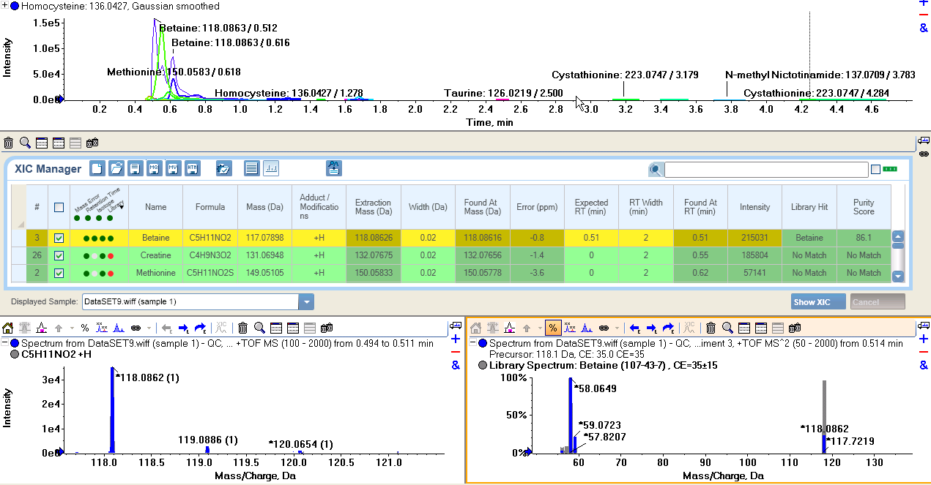
Metabolite Identification and Confirmation Against Accurate Mass Libraries
Retention Time
Mass Accuracy
Isotope Pattern
Library high and Purity Score

Slide 21
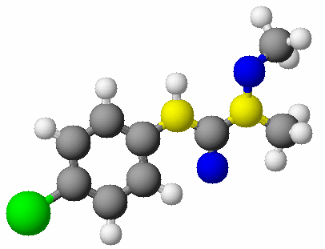
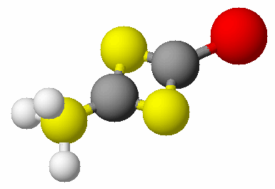
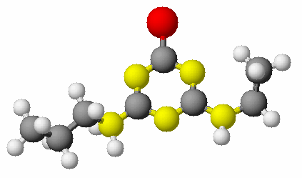
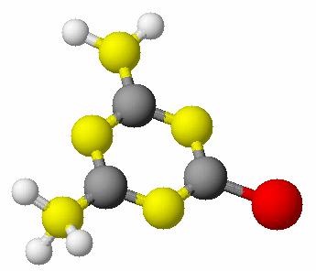

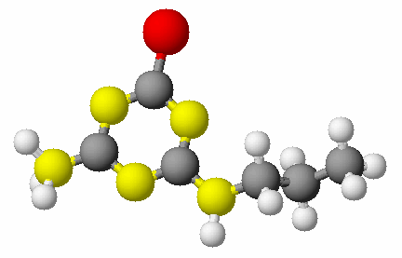
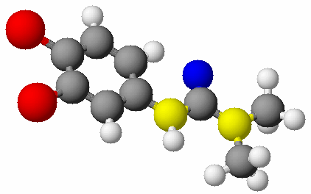
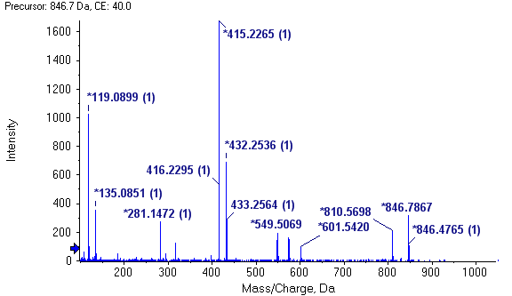
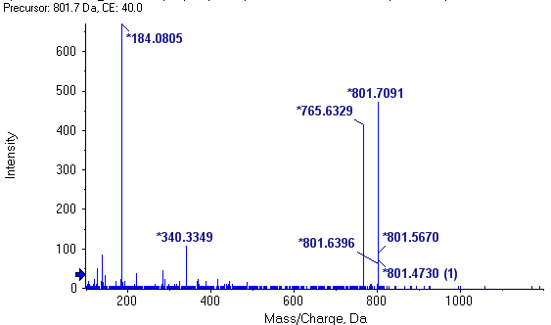
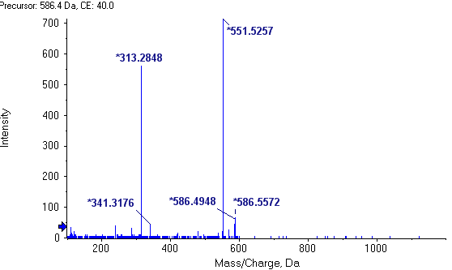
Data Independent SWATH MS for Lipidomics
Full MS/MS Archive of Every Compound in the Sample
Q1
Q2
Direct infusion, flow injection, and lipid-class targeted LC techniques
Fast Q1 precursor selection step-wise through mass range
CID Fragmentation
Collection of High resolution MS/MS

Slide 22
MS/MS^{ALL} Acquisition Method Set-up
cycle time
~ 3.3 min
1200.051
705.555
704.554
200 - 1200 (m/z)
703.553
702.552
Q1 mass filter width = 0.7 Da
701.551
700.550
200.0550
acquisition time

Slide 23
450 Human Plasma Lipids Profiled in 6 min using SWATH™ Acquisition
Diacyl phospholipids
Ether-linked/plasmalogen phospholipids
Storage lipids
*Data processed by LipidView™ Software
Notes:
SPIF delivered quantitative information for more than 450 molecular lipid species of the human plasma lipidome in less than 12 minutes, covering positive and negative polarities, without compromising data quality. The results were well in-line with previous observations (3). The total number of diacyl phospholipids, ether-linked/plasmalogen phospholipids and storaged lipids, including their respective subgroups are shown.

Slide 24
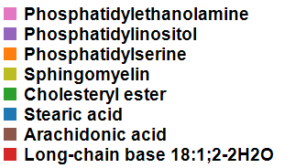

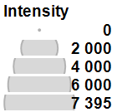
Infusion SWATH of Human Plasma
Total Ion Map
PE 18:0/20:4
PI 18:0/20:4
Notes:
LipidView™ processed data of the precursor ion mass range, m/z 550-900 (x-axis) and the fragment ion mass range, m/z 100-700 (y-axis) is shown. The output assists to identify precursor ions that share specific fragment ion signatures and pinpointing the fragment ions of a particular precursor ion, as demonstrated by the highlighted lipid characteristic ions.

Slide 25
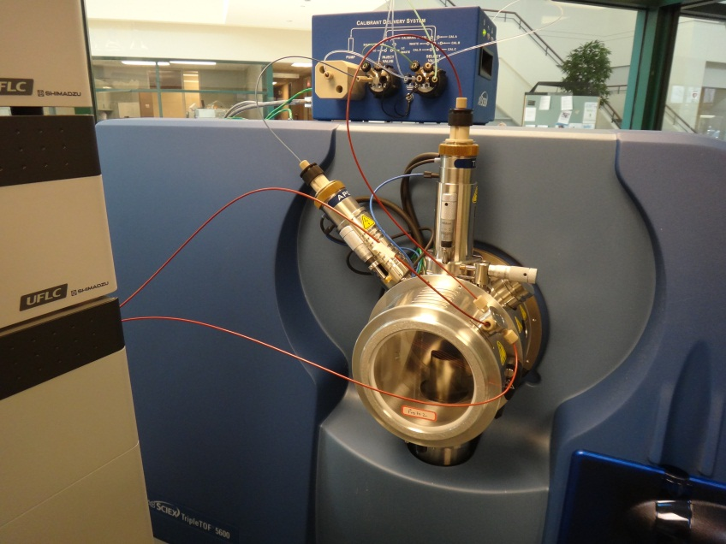
Infusion SWATH Configuration
Method Set-up
Bligh-Dyer extraction with surrogate standard cocktail
Infuse sample (µM) in 4:2:1 IPA/CHCl₃/MeOH (10mM NH₄OaC)
Positive and Negative TOF MS and MS/MS^{ALL} acquired sequentially in 3.3 minutes
Data analysis, quantitation, results interpretation
Calibrant delivery (APCI)
ESI
Make-up Flow
Sample infusion
Shotgun Lipidomics by Sequential Precursor Ion Fragmentation on a Hybrid Quadrupole Time-of-Flight Mass Spectrometer
Simons B, Kauhanen D, Sylvänne T, Tarasov K, Duchoslav E, Ekroos K. Metabolites 2012, 2, 195-213.

Slide 26
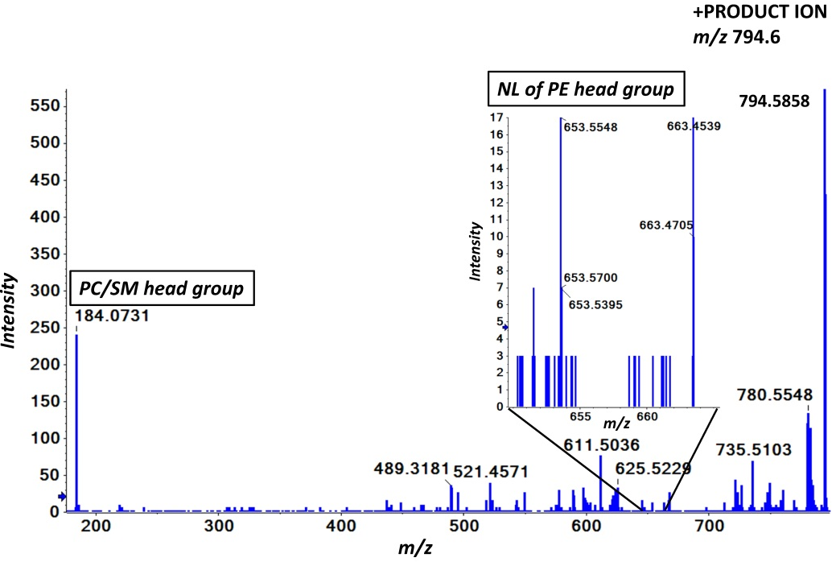
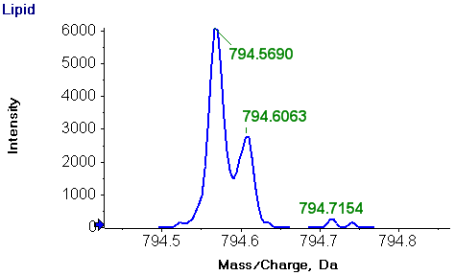
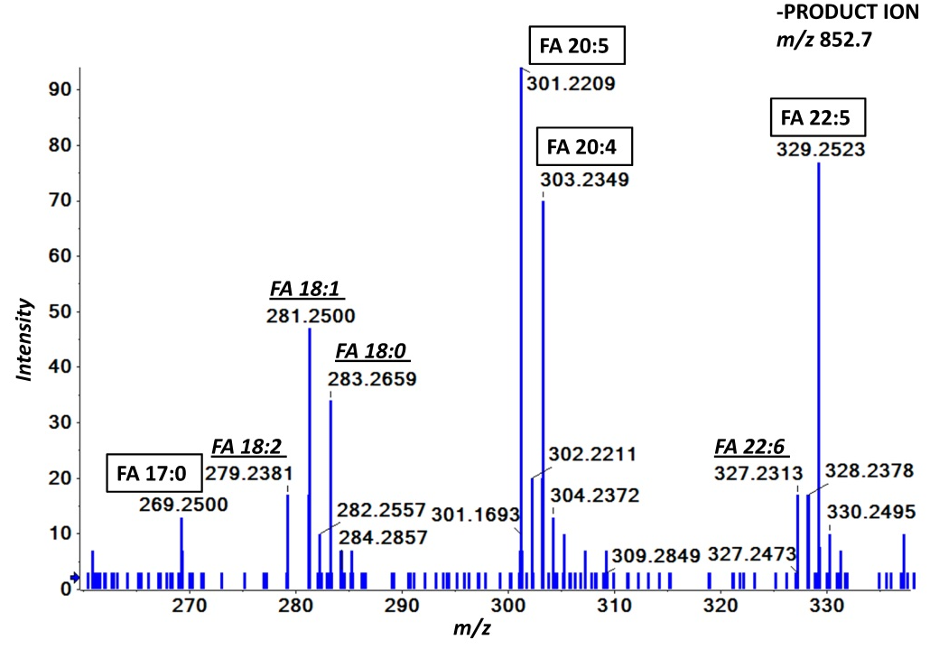
MS/MS for Lipid Identification
+ MS/MS^{ALL}
measured mass: [C₄₅H₈₀NO₈P+H]⁺
theoretical mass: 794.5694
mass error: 0.5 ppm
measured mass: [C₄₆H₈₄NO₇P+H]⁺
theoretical mass: 794.6058
mass error: 0.6 ppm
Intensity, cps
- MS/MS^{ALL}
Notes:
TOF MS reveals two distinct peaks at m/z 794.5690 and at m/z 794.6063 suggesting the presence of both PC 37:5 and PC O-38:5. +MS/MS of the precursor ion confirms the presence of PC, based on the detection of the phosphoryl choline head group, but simultaneously reveals the presence of PE species based on the detection of the mass at m/z 653.5548, corresponding to the NL of the PE head group. -MS/MS of the precursor ion monitored as an acetate adduct, detects the underlying acyl anions. Collectively the obtained results propose the presence of PC 17:0/20:5, PC P-18:0/20:4, PC O-18:0/20:5 and PC O-16:0/22:5. The raw MS/MS further suggests the presence of overlapping lipid species based on the detected acyl ions (italic underlined) which partially originate from isotope peaks of lower mass lipids.

Slide 27
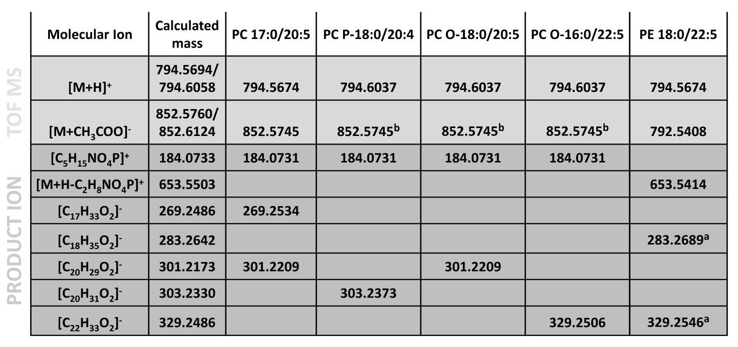
Definitive Lipid Molecular Species Identification
Only MS/MS pos and neg spectra combined provide the distinguishing fragments to identify PC 37:5, PC O-38:5, & PE 40:5

Slide 28
Lipid Relative Quantification of CER d17:0/17:0 Corrected by CER d17:1/18:0 IS
Quantitative Performance of a QqQ Instrument
R² > 0.994
MS/MS^{ALL} on TripleTOF® System
Peak intensity ratio of m/z 250.25 / m/z 264.27
Precursor Ion scanning on QTRAP® 5500 System
LC-MRM on 4000 QTRAP® System
Concentration, µM
Shotgun Lipidomics by Sequential Precursor Ion Fragmentation on a Hybrid Quadrupole Time-of-Flight Mass Spectrometer
Simons B, Kauhanen D, Sylvänne T, Tarasov K, Duchoslav E, Ekroos K. Metabolites 2012, 2, 195-213.
Notes:
Human plasma total lipid extracts spiked with isobaric ceramide standards. The peak intensities of the fragment ions corresponding to d17:1 and d18:1 sphingosine respectively, were obtained from the MS/MS^{ALL} acquisitions. CER d17:1/17:0 standard was serial diluted relative to a constant amount of the synthetic CER d18:1/17:0 standard. The y-axis shows the ratio of the intensities of spectral peaks at the m/z 250.25 and 264.27 and the x-axis represents the absolute concentration of CER d18:1/17:0 (N=3).

Slide 29
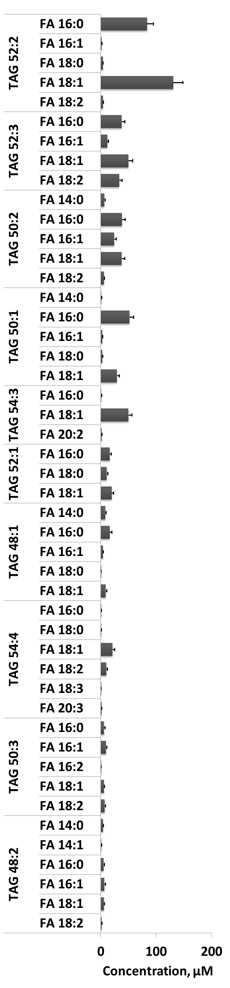
TAG Lipid Profiling in Plasma
concentration, µM
0
100
+MS TAG 52:3
+MS/MS of TAG 52:3 NL 18:0
200
Group A
Group B
Group A
Group B

Slide 30

SWATH [MS/MS^{ALL}]
LC MRM

Slide 31

Acknowledgments
University of Toronto & Toronto General Hospital
    Johanne Allard
    Bianca Arendt
    Elaheh Aghdassi
    David Ma
VTT Technical Research Institute of Finland
    Kari Raino
Zora Biosciences, Fi
    Kaisa Koistinen
    Kim Ekroos
AB SCIEX
    Ron Brejak
    Paul Baker
    Dan Puscasu
    Eva Duchoslav
    Gary Impey

Slide 32

Questions and Answers

Slide 33
Trademarks/Licensing
For Research Use Only. Not for use in diagnostic procedures.
The trademarks mentioned herein are the property of AB Sciex Pte. Ltd. or their respective owners. AB SCIEX™ is being used under license.
© 2012 AB SCIEX.

Slide 34
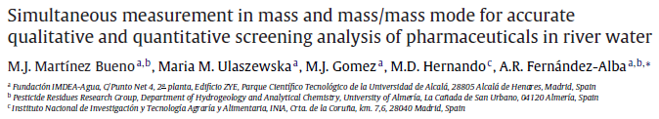
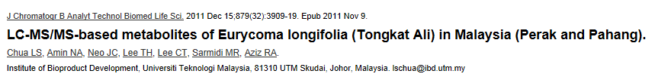
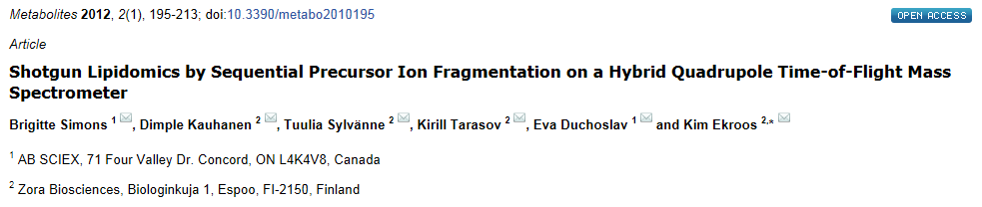
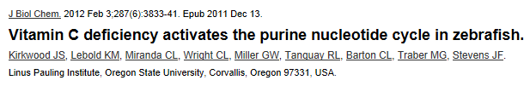
TripleTOF® 5600⁺ System
Publically Available Application Data and Publications
Lipidomics and Metabolite Identification

Slide 35
Conclusion
MS/MS^{ALL} with SWATH™ Acquisition is a novel data-independent acquisition strategy that provides:
  Comprehensive high resolution MS/MS data for all detectable ions
  High quality quantitation similar to MRM with no method development
  Easy and retrospective data interrogation
SWATH Acquisition is ideal for quantifying extremely large numbers of peptides in complex samples
  Biomarker verification
  Network biology
SWATH data can be processed by PeakView and MarkerView
or extracted for use with 3rd party informatics tools

